Slide 1

Welcome to the Eastside church of Christ
Notes:
1
1

Slide 2
Future Gospel Meetings
June 14-19, 2015 Gardner Hall & Now in Progress! Jerry Falk
November 1-3, 2015 Eric Reynolds
June 12-17, 2016 Lowell Sallee
June 4-9, 2017 David Maxson
June 17-22, 2018 Greg Chandler

Slide 3



Gospel Meeting At Eastside – June 14-19
“Strength for Life‘s Battles”
Lessons by Gardner Hall
Sunday at 9 a.m. & 3 p.m.
Monday – Friday at 7:00 p.m.
“Personal Preparation in Evangelism”
Lessons by Jerry Falk
Monday – Friday at 10 a.m.
“Joy at the Jordan”
Lessons for Little Ones (1 yr. – 3rd grade)
Monday – Friday at 10 a.m.

Slide 4

For the sick and the shut-in,
live video of our services
is provided through
the media link
on our website at
www.eastside-church.org

Slide 5
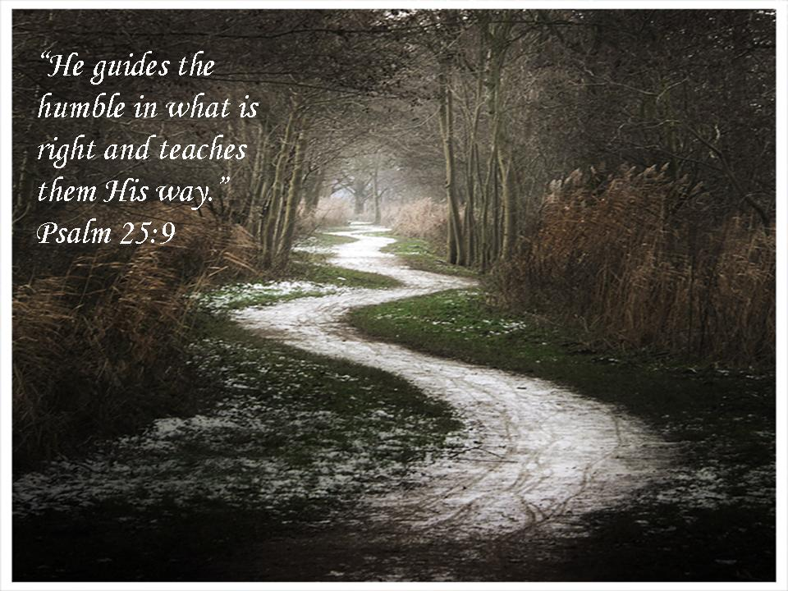

Slide 6


Slide 7
